Slide 1





COVID-19 Genomic Data: Diverse Enough?
Nathanael Sheehan
Exeter Centre for the Study of Life Sciences
(Egenis), University of Exeter
@thanaelsheehan

Slide 2
Outline
Outline of Case Study
Quantitative Results
Philosophical Framing
Reflections

Slide 3
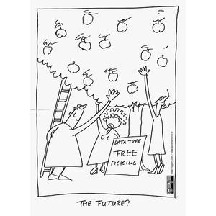
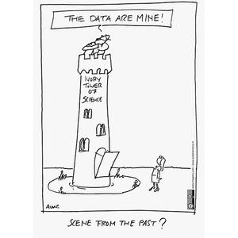
Genetic data sharing: a “success story”?
Obvious urgency to identify and track SARS-COV-2 variants
Easiest data to share from technical perspective
Building on decades of efforts towards sharing of sequencing data
Illustrations accessed from
https://www.fosteropenscience.eu/

Slide 4

Accountable data sharing: Global Initiative on Sharing All Influenza Data
2008: share influenza genomic data securely and responsibly
an alternative to the public domain sharing model
Grounded on agreement governing data access and re-use
requires users to authenticate their academic identity and agree not to republish or link GISAID genomes without permission from data producer
fosters trust and information exchange among groups that differ in their geo-political locations, funding levels, material resources and social characteristics, thereby expanding the range of data sources shared online
Notes:
Launched on 100 year anniverdsary of 1918 Spanish flu
Based inGermany, now financed through agreement across private and public contributors (e.g. FIOCRUZ)
Since its launch GISAID plays an essential role in the sharing of data among the WHO Collaborating Centers and National Influenza Centers for the bi-annual influenza vaccine virus recommendations by the WHO Global Influenza Surveillance and Response System (GISRS).
* = I have two books and several articles on this issue, illustrating this with very in-depth examples, but no time now!

Slide 5
Accountable data sharing: Global Initiative on Sharing All Influenza Data
2020: redeployed as to include SARS-COV-2 data
EpiCov database stores, analyses and builds evolutionary trees of SARS COV-2 genome sequences
Now leading open access database for SARS-CoV-2, over 13 million genomes sequenced by November 2022
Key role in identifying and studying variants of interest, variant evolution and lineages, spread in real-time
Funded by public-private partnerships (Federal Republic of Germany, public-health and academic institutions in Argentina, Brazil, China, Republic of the Congo, Ethiopia, Indonesia, Malaysia, Russia, Senegal, Singapore, South Africa + bottom-up Friends of GISAID)
Notes:
Based inGermany, now financed through agreement across private and public contributors (e.g. FIOCRUZ)
Since its launch GISAID plays an essential role in the sharing of data among the WHO Collaborating Centers and National Influenza Centers for the bi-annual influenza vaccine virus recommendations by the WHO Global Influenza Surveillance and Response System (GISRS).
* = I have two books and several articles on this issue, illustrating this with very in-depth examples, but no time now!

Slide 6
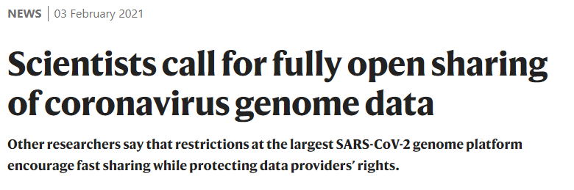
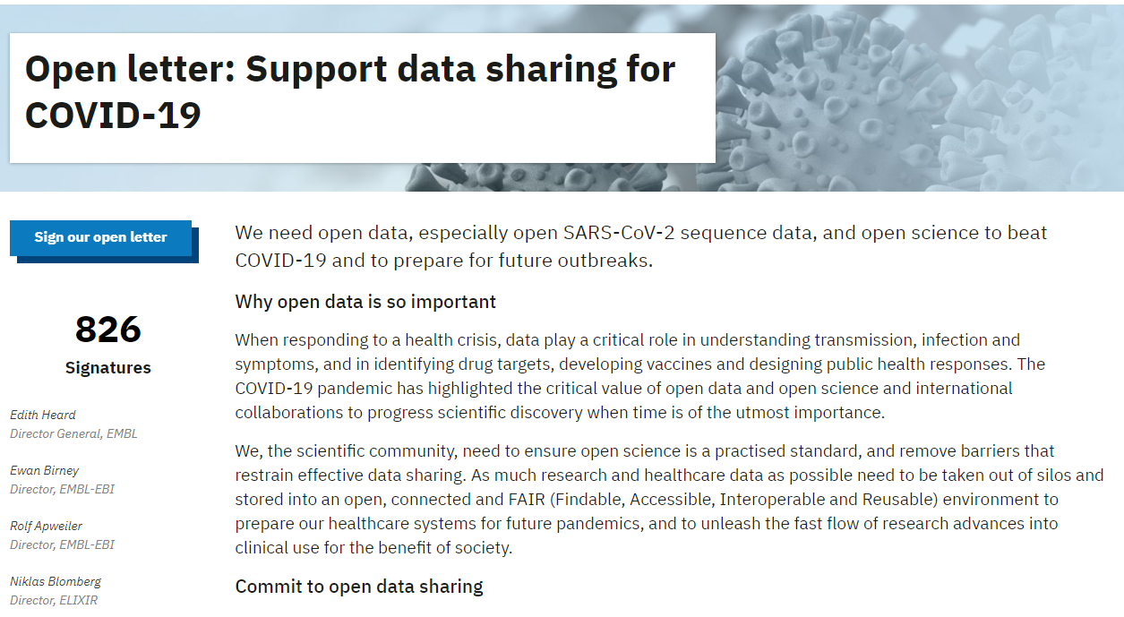
Not open enough?
29/01/2021: government board of European Bioinformatics Institute posts letter in Nature calling for greater openness in sharing SARS-CoV-2 genome data
Worry: limiting the extent to which data can be accessed and linked can negatively affect the insight, pace and breadth of future research
“to unleash the fast flow of research advances” the scientific community must remove all formal barriers which restrict data sharing and share all SARS-CoV-2 genome sequences
signed and promoted by Nobel Laureates, directors of bioinformatics programs and many leading researchers concerned about urgency of an effective pandemic response
Notes:
“to unleash the fast flow of research advances” the scientific community must remove all formal barriers which restrict data sharing and share all SARS-CoV-2 genome sequences to one of a triad of state genomic surveillance programs (EBI, The GenBank of USA and the DNA Data Bank of Japan)

Slide 7
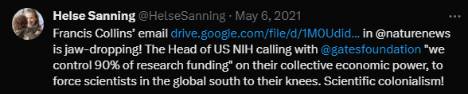
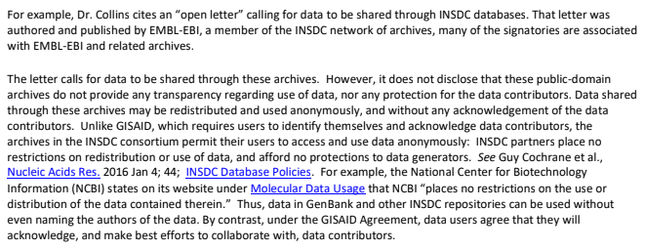
Not Open Enough?
29/04/2021: an email thread between the heads of research institutes and GISAID is leaked by burner account @HelseSanning
The email begins as GISAID questions why they are not being invited to a meeting discussing the future of SARS-CoV-2 genomic repositories
The letter discusses several perceived tensions: access of data, terms of use, data rights, funding , sharing and dodgy citations.
The letter concludes with support from a researcher in South Africa, claiming “Scientists feel a movement, to try to bypass GISAID and make all of the data public before analysis at INSDC is not good for South Africa, as GISAID protects data access and we deposit all of our data as produced”

Slide 8
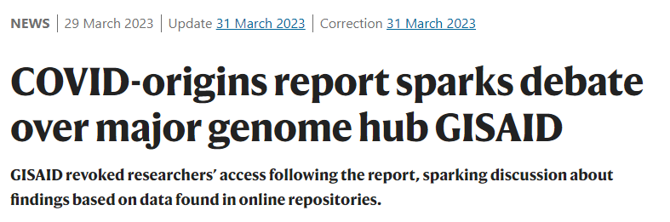
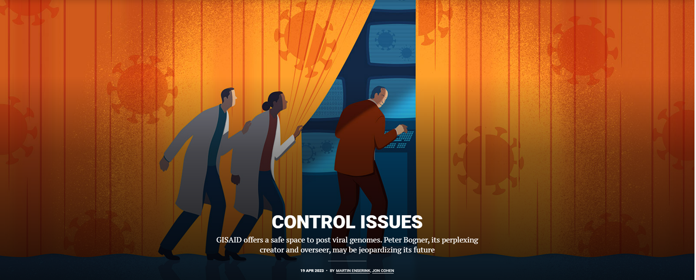
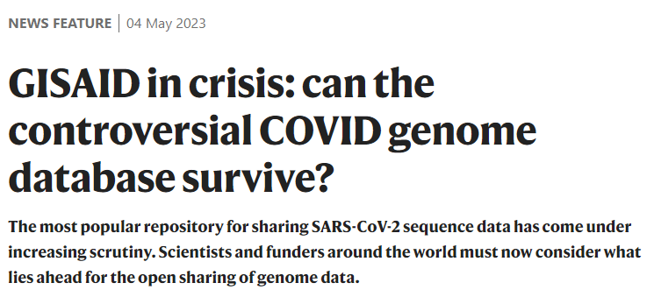
Not open enough?
May 2023: investigations by Science and Nature magazines over the management and governance of GISAID
Worries about opaque governance, calls for shutting it down in a hurry
Accusations of selective / “adjusted” data releases depending on who is asking and their relationship to GISAID
Blurred line between retribution for past misdemeanours (breaking GISAID data sharing policies) and unwarranted denial of access
Extremely hard to adjudicate especially given existing prejudice against GISAID model
In any case, clearly non-transparent management, badly suited to accountability regime it is meant to exemplify
Notes:
“to unleash the fast flow of research advances” the scientific community must remove all formal barriers which restrict data sharing and share all SARS-CoV-2 genome sequences to one of a triad of state genomic surveillance programs (EBI, The GenBank of USA and the DNA Data Bank of Japan)

Slide 9

Pushing for actionable data: COVID-19 Data Portal
EU/EMBL/Elixir alternative since April 2020
“accelerating research through data sharing”, ca. 6 million sequences to date
bulk downloads with no user tracking
strong emphasis on interoperability
includes / links with wide variety of data, including protein, expression, networks, imaging, even socio-economic data
provides full version history
links up to publications in which sequence was used
direct links to samples facilitating sourcing and cross-analysis
Actionability: capacity to re-purpose data for novel goals and research settings
Different from highly specific understandings of actionability within biomarkers research in oncology

Slide 10
A Tale of Two Data Infrastructures
Architecture
Submissions
Reuse
Notes:
Archictecture

Slide 11
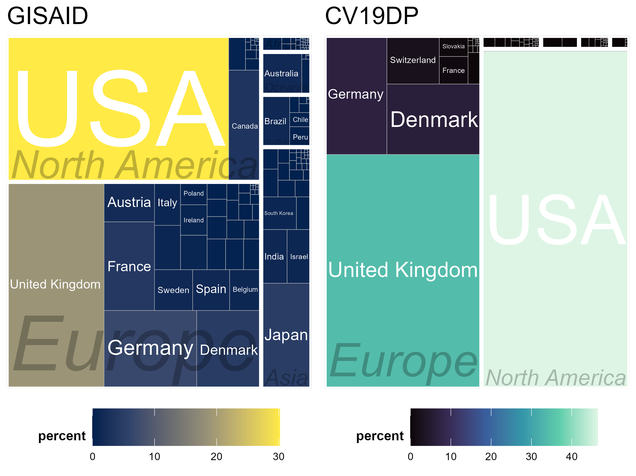
A Tale of Two Data Infrastructures
From Collection to Analysis: A Comparison of GISAID and the Covid-19 Data Portal
Nathanael Sheehan, Sabina Leonelli, Federico Botta
bioRxiv 2023.05.13.540634; doi: https://doi.org/10.1101/2023.05.13.540634

Slide 12
Our Findings Suggest
GISAID
Very limited actionability
No links to publications or samples (only information)
No advanced model for data linkage beyond the viral genome, esp. problematic when considering human hosts
Doubts emerging about GISAID governance and accountability to users as an organization
Including possible problems with data requests and access
CV19DP
Very limited accountability
Less tools for collaborative research discovery
No limits on access which in turn means less foresight on potential reuse scenarios

Slide 13
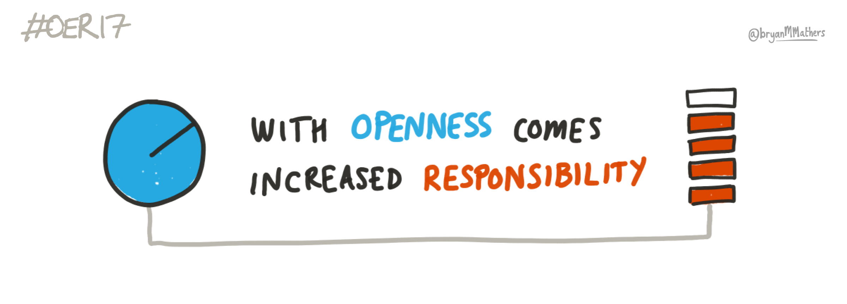
Trade-off?
Perceived trade-off between representativeness and actionability of data
C19DP: priority on making data “reusable”, rather than just accessible
open data to unexpected re-purposing through interoperable standards/tools
GISAID: priority on enhancing comprehensiveness of coverage and accountability to sequence ‘donors’
Science is not a level playing field + methodological cutting-edge does not necessarily support inclusion and trust
need to ensure representativeness of data samples through appropriate data governance and tech choices
An ongoing challenge, at once ethical and epistemic: Different interpretations of openness and responsible research
?
openLab des Universitätskolleg DIGITAL der Universität Hamburg
Notes:
e.g. protection of vulnerable / discriminated researchers; fields using sensitive data and/or materials
*Leonelli 2010, 2013, 2016, 2018, 2019, 2020, 2021.. I am like a broken disk
openLab des Universitätskolleg DIGITAL der Universität Hamburg.
Quelle Titelbild: "With Openness comes increased responsibility" - sketch by Bryan M Mathers (@bryanMMathers), under a CC-BY 4.0 licence https://lab.flavoursofopen.science/nachlese-oer17-london-uk-05-06-april-2017/

Slide 14
Overcoming the ‘trade-off’ framing
Data actionability is not just about technical opportunities (linkage, standardization, interoperability, multi-scale modelling)
Actionability includes
management of transdisciplinary expertise of relevance to data interpretation
investment in trustworthy governance to increase participation and thereby representativeness of data
transparent governance and accountability to contributors and users
[Leonelli 2016, 2018, Tempini and Leonelli 2019, Beaulieu and Leonelli 2021]

Slide 15
Data Representation
Making data actionable for knowledge development involves a commitment to ensuring that the data in question are representative of the phenomena being studied.
This in turn presupposes that:
enough data are contributed by a wide and diverse set of relevant sources;
mechanisms of feedback and inclusion are set up to ensure that data contributors can participate data governance and interpretation, thereby helping to adequately contextualise data;
accountability extends to the ways in which data infrastructures are run, financed and positioned vis-à-vis the communities they are meant to serve.

Slide 16
Conclusions
Crucially, such a model of data sharing can only work on the understanding that data do not need to be easily accessible in order to be actionable
rather, actionability depends first and foremost on the responsiveness and accountability of data infrastructures, and the efforts invested in ensuring an open communication among contributors.

Slide 17

Thank you
We would like to thank
the authors from the originating labs - together with the submitting labs - who were responsible for collecting, codifying and sharing the pathogen related data to which this analysis relies on
the Our World in Data team for their efforts in collecting and curating the epidemiological data used in this study
Carole Goble for relevant discussions, support and help with finding resources and interlocutors

